Slide 1

Heart Disease Prediction
By Gloria ISEDU

Slide 2

Contents
Problem Statement*i
Objective
Dataset Overview
Exploratory Data Analysis (EDA)
Model Selection
Model Performance
Insights

Slide 3


1. Problem Statement
Cardiovascular disease is any disease involving the heart or blood vessels.
Why early prediction is important If we can predict it, it can be prevented for people with the same profile.

Slide 4
2. Objective of the project?
Develop a machine learning model to predict the likelihood of heart disease

Slide 5
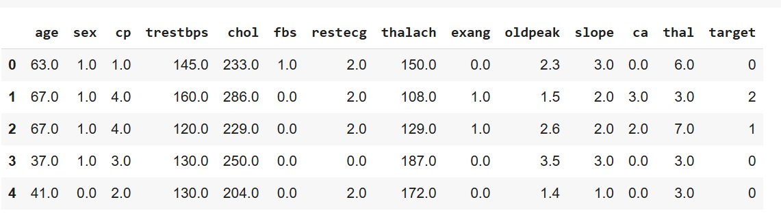
3. Dataset Overview.
UCI Heart Disease Dataset
303 rows and 14 columns

Slide 6
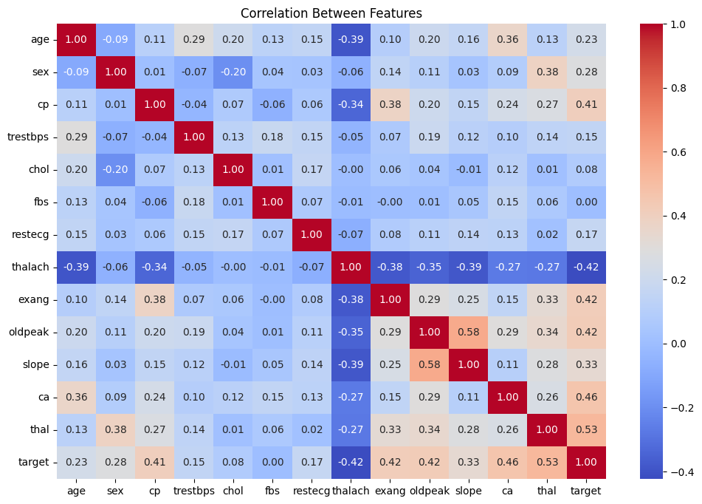
4. Exploratory Data Analysis(EDA): Correlation matrix of columns

Slide 7
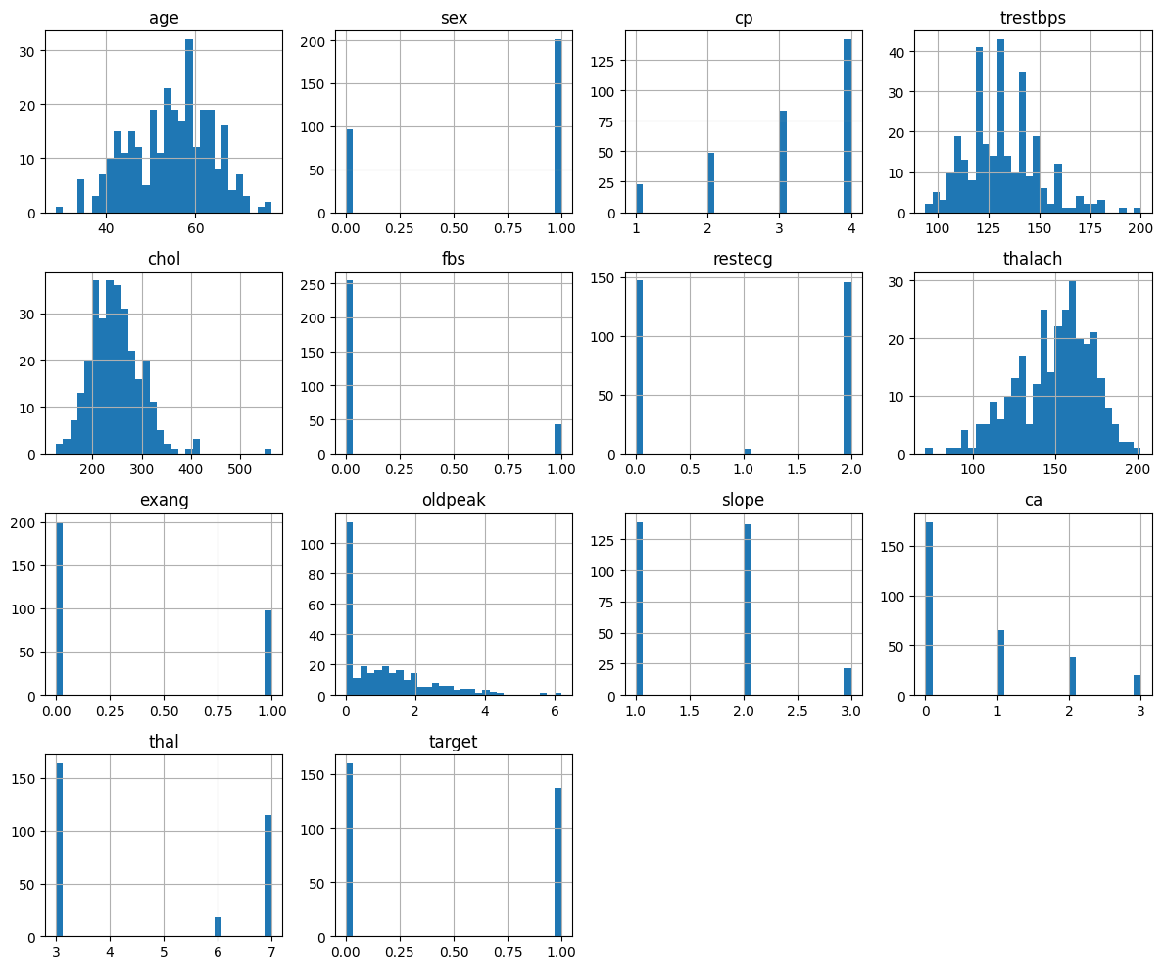
Exploratory Data Analysis(EDA): Distributions of columns

Slide 8
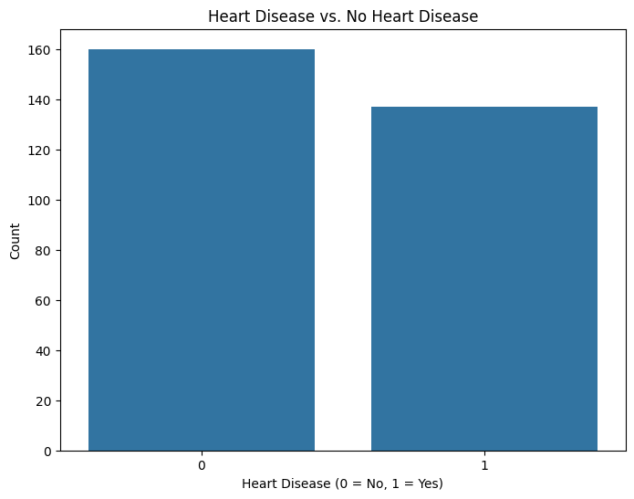
Exploratory Data Analysis(EDA): No class imbalance

Slide 9
2. Examples
By the end of this section, your audience should be able to visualize:
What What is the pain you cure with your solution?
Who Show them a specific person who would benefit from your solution.

Slide 10
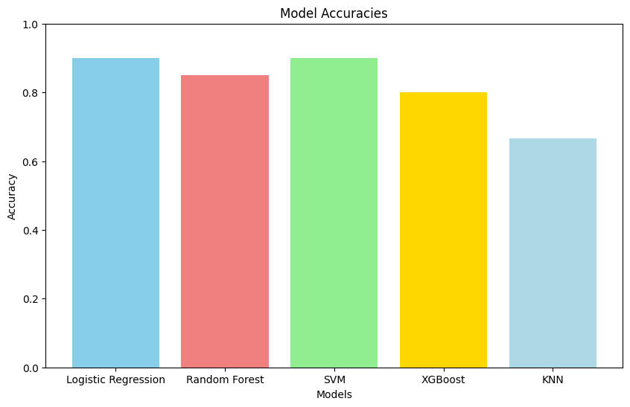
5. Model Selection
HeThe models tested were Logistic regression, random forest, SVM, KNN and XGBoost. Logistic regression for it’s classification applicability, Random Forest for it’s ensemble method(same with XGBoost), and KNN for being a simple yet efficient algorithm for classification.
Tip
Tell the audience about the problem through a story, ideally a person.

Slide 11
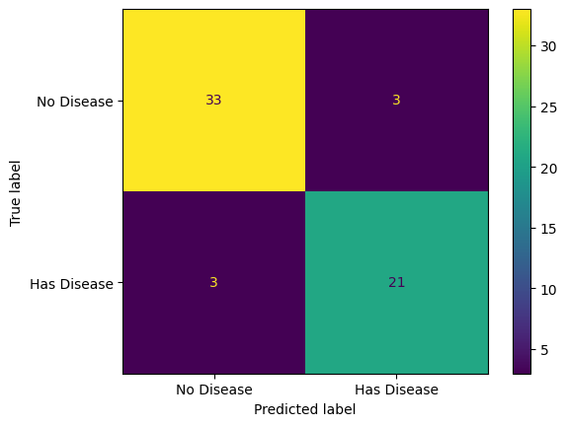
6. Model Performance
Logistic Regression
Tip
If one example isn’t sufficient to help people understand the breadth of your idea, pick a couple of examples.
Story for illustration purposes only

Slide 12

6. Model Performance
Random Forest
Tip
Show how your solution helps the person in the story reach his or her goals.

Slide 13
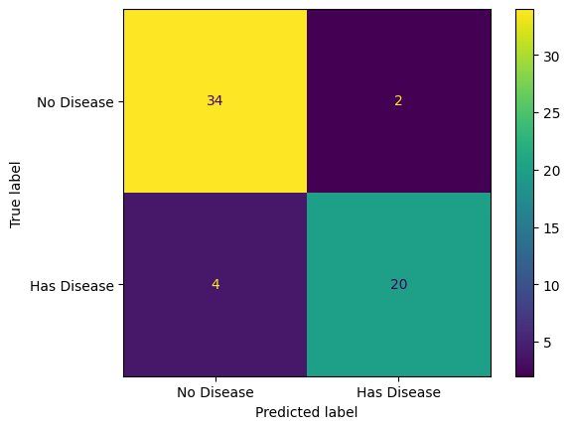
6. Model Performance
SVM
Tip
If one example isn’t sufficient to help people understand the breadth of your idea, pick a couple of examples.
Story for illustration purposes only

Slide 14
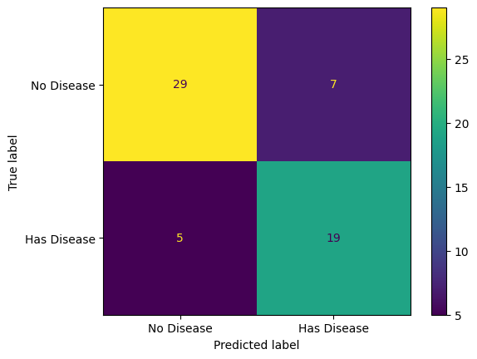
6. Model Performance
XGBoost
Tip
Show how your solution helps the person in the story reach his or her goals.

Slide 15
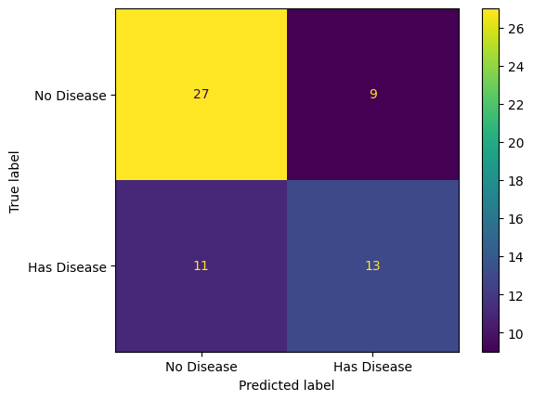
6. Model Performance
KNN
Tip
If one example isn’t sufficient to help people understand the breadth of your idea, pick a couple of examples.
Story for illustration purposes only

Slide 16
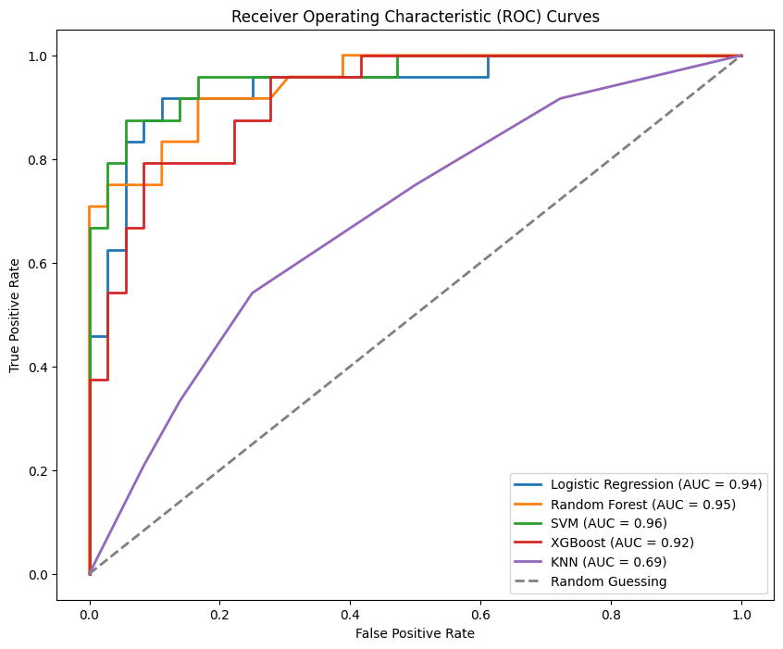
6. Model Performance
Tip
Show how your solution helps the person in the story reach his or her goals.

Slide 17
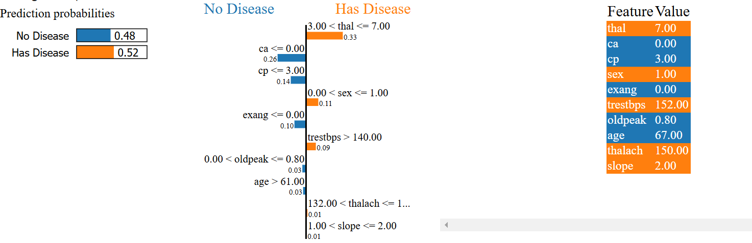
7. Insights

Slide 18
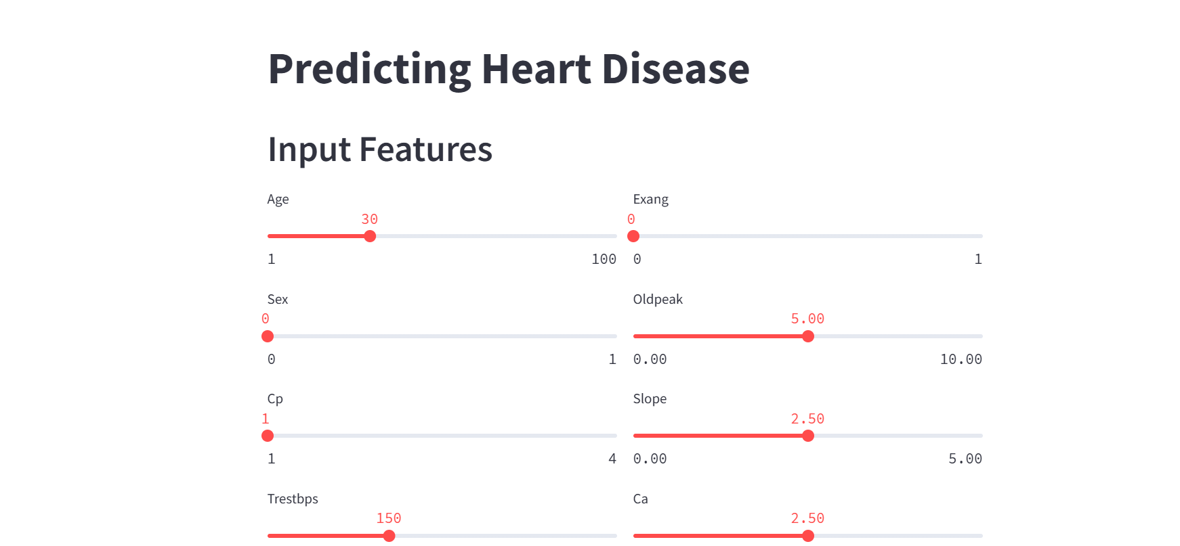
Sample UI

Slide 19
Link to project on github: https://github.com/purple-mustache/DSN_ml_project/tree/main
Link to project notebook: https://github.com/purple-mustache/DSN_ml_project/blob/main/Heart_Disease_Classification.ipynb

